Slide 1
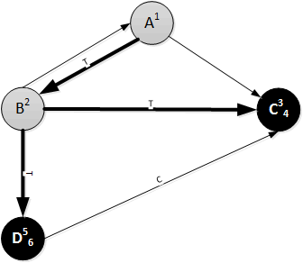

DFS Example – Step 6
Vertex | A | B | C | D
Discovery Time | 1 | 2 | 3 | 5
Finishing Time |  |  | 4 | 6
Edge | AB | AC | BA | BC | BD | DC
Type (BCFT) | T |  |  | T | T | C

Slide 2
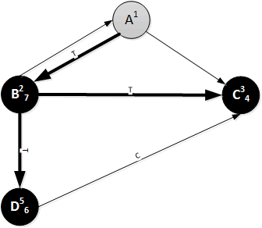
DFS Example – Step 7
Vertex | A | B | C | D
Discovery Time | 1 | 2 | 3 | 5
Finishing Time |  | 7 | 4 | 6
Edge | AB | AC | BA | BC | BD | DC
Type (BCFT) | T |  |  | T | T | C

Slide 3
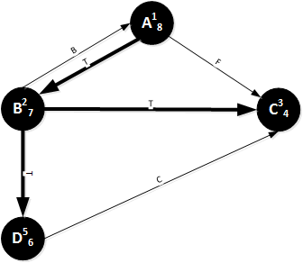
DFS Example – Step 8
Vertex | A | B | C | D
Discovery Time | 1 | 2 | 3 | 5
Finishing Time | 8 | 7 | 4 | 6
Edge | AB | AC | BA | BC | BD | DC
Type (BCFT) | T | F | B | T | T | C

Slide 4
Numberings (Times) & Edge Types
Edge (u,v)
Vertex u has discovery time u.d and finishing time u.f
Vertex v has discovery time v.d and finishing time v.f
u.d < v.d and u.f > v.f ⇒ Tree or forward edge
If v is WHITE/BLUE when (u,v) is explored, tree edge
Else forward edge
u.d > v.d and u.f < v.f ⇒ Back edge
V.d < v.f < u.d < u.f ⇒ Cross edge

Slide 5
Digraphs: Node types
Source: A node with no incoming edges
Indegree = 0
Sink: A node with no outgoing edges
Outdegree = 0

Slide 6
Directed Acyclic Graph (DAG)
A Digraph has a cycle iff it has a back edge
Digraphs with no cycles are useful for many things, including ordering of activities
Topological sort
Every DAG has at least one source and one sink

Slide 7
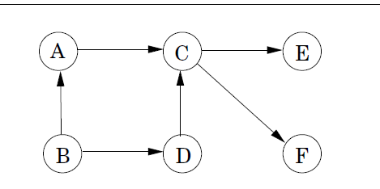
Topological Sort of a DAG
A topological sort is a linear ordering of all the vertices such that if G contains an edge (u,v) then u appears before v in the ordering.

Slide 8
Topological Sort of a DAG
One valid topological sort is always found by doing a DFS, then processing the nodes in order from highest to lowest finishing number.

Slide 9
Some Uses of Topological Sort
Task scheduling
Critical path analysis
Build dependencies in large systems
Spreadsheet recalculations after changing a value

Slide 10
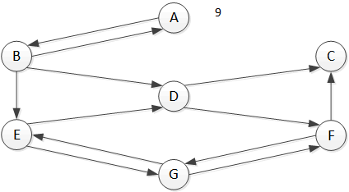
Strongly Connected Components
Recall that a Strongly Connected Component in a Directed Graph (SCC) is a (sub)set of the nodes such that every node in the subset is reachable from every other node.

Slide 11
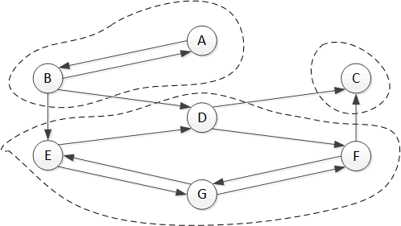
Strongly Connected Components
Here are the SCCs in the previous graph.

Slide 12
Finding the SCCs
A way to use DFS to find the SCCs in a directed graph is to use Kosaraju’s algorithm.
My notes follow geeksforgeeks.org
Same idea as textbook

Slide 13
Kosaraju’s Algorithm
Do DFS on the original graph G=(V,E). When you finish a node, push it onto a stack.
After DFS is finished, create graph G’=(V,E’) by reversing the sense of each edge.
If (u,v) ∈E, then (v,u) ∈E’
Do DFS on graph G’, starting with the last node to finish (on top of the stack).
Every node reachable from a given node is in an SCC with that node.
Remove nodes from the stack when reached.

Slide 14
Example
Start with node A (doesn’t matter where you start, though)

Slide 15
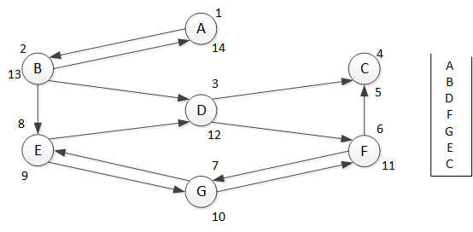
First DFS Pass w/Stack

Slide 16
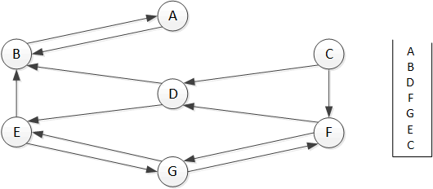
Second DFS Pass

Slide 17
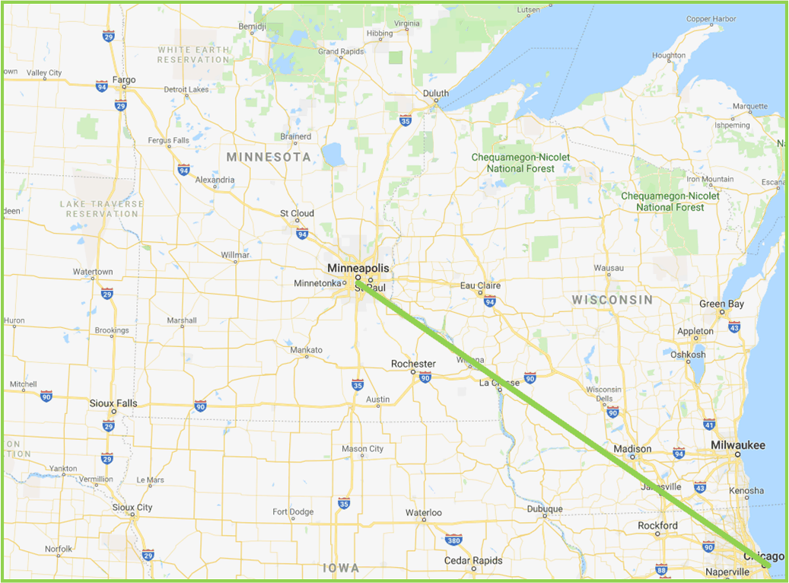
Heuristic Search 1
Say we want the shortest path to somewhere. Maybe you want to drive to Chicago.

Slide 18
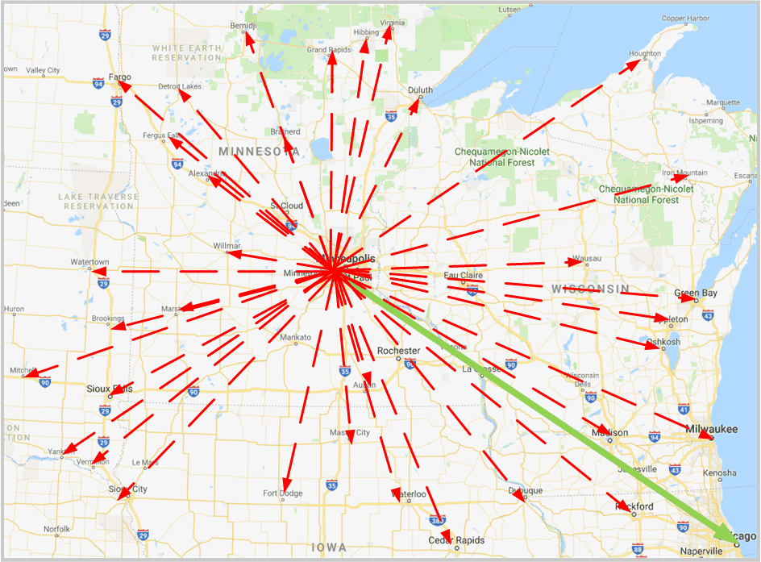
Heuristic Search - LCFS
LCFS will find the shortest path in time O(V lg E). But it will find the shortest path to all closer points first.

Slide 19
Heuristic Search (Idea)
Don’t ignore the goal when selecting paths.
Often there is extra knowledge that can be used to guide the search : heuristics
h(n) is an estimate of the cost of the shortest path from node n to a goal node
h(n) needs to be efficient to compute.
h can be extended to paths: h(n₀,…,n_{k}) = h(n_{k})
h(n) is an underestimate if there is no path from n to a goal with cost less than h(n).
An admissible heuristic is a nonnegative heuristic function that is an underestimate of the actual cost of a path to a goal.

Slide 20
Example Heuristic Functions
If the nodes are points on a Euclidean plane and the cost is the distance, h(n) can be the straight-line distance from n to the closest goal.
If the nodes are locations and cost is time, we can use the distance to a goal divided by the maximum speed.
A heuristic function can be found by solving a simpler (less constrained) version of the problem.

